Slide 1
US Population clustering by states
By arabi sami

Slide 2
Introduction
It is important to determine a city’s, region’s or state’s population
This can be very helpful in tasks such as resources distribution, network allocation
We would like in this project to make an analysis on US Population by State by clustering the different states based on their coordinates and population.

Slide 3
Data acquisition and preparation
We will be using the US City Populations Dataset
Data includes every city name (over 6k), its population and state.
we will delete the city column and group the dataframe by state, then sum the population for each city in that state.
There are apparently no missing, or wrong values in the dataset

Slide 4
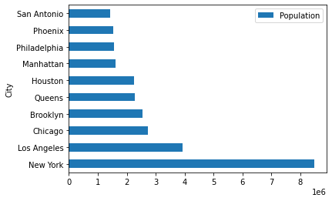
Most populated cities
Here we can see that New York, Los Angeles and Chicago are the most populated cities in 2015.

Slide 5
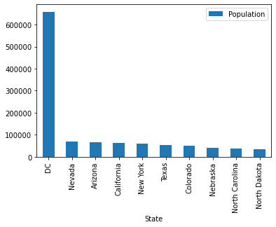
Most populated States
The DC state has by far the most population. Followed by Nevada, Arizona and California

Slide 6
Number of cities per state
We can see here that most states have between 0 and 50 cities. Less states have more than 50 cities. Only few states have more than 600 cities.

Slide 7
States clustering
We will now make a clustering of the different states, we want the clustering to be done taking into account two criteria’s : The coordinates of the state, and its population (the sum of the population of each city in this state).

Slide 8
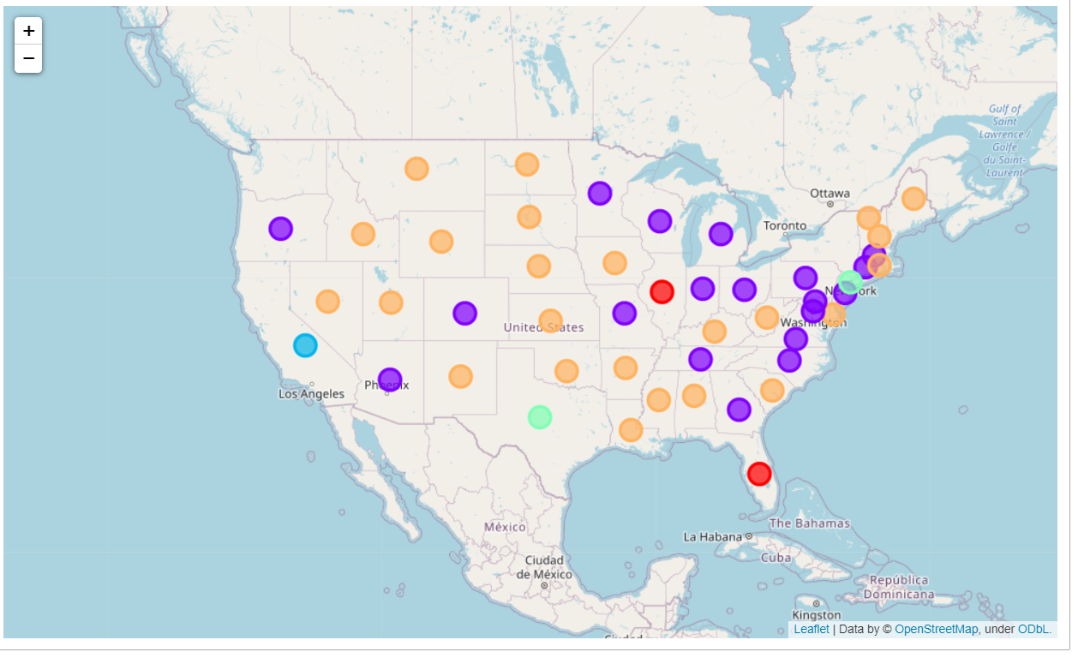
Results visualization

Slide 9
Results interpretation
We can see that a cluster has appeared in the East of America, this corresponds to states that are more populated than other states in the center of USA.

Slide 10
Conclusion and future directions
Taking into account more variables to make the clustering
Try out different clustering algorithms
Make a grid search to find the best value of n_clusters

